Slide 1
Next Up:
Demitrius Nelon

Slide 2
3
3

Slide 3
2

Slide 4
1

Slide 5
WinGet Configuration
Demitrius Nelon

Slide 6

Many thanks to our sponsors:

Slide 7


Demitrius Nelon
Senior Product Manager
Microsoft
I'm a product manager at Microsoft working on the Windows Package Manager. I've worked at a few other companies you might have heard of like Amazon, Verizon and VMWare, and a few you might not have heard of like FlashNet and Unbound Technologies. I love building products and digging into useless trivia.
WinGet

Slide 8
WinGet Configuration
Configuration as Code
Orchestration via configuration file (*.dsc.yaml)
Built on PowerShell DSC (v2)

Slide 9
Building and Testing
Start with samples
Windows Sandbox
Dev Home – Environments
Invoke-DscResource

Slide 10
Some assembly required
Install-WinGetPackage Microsoft.PowerShell
Install-Module -Name Microsoft.WinGet.Configuration -AllowPrerelease
Install-Module -Name PSDesiredStateConfiguration
Install-Module -Name PSDscResources

Slide 11
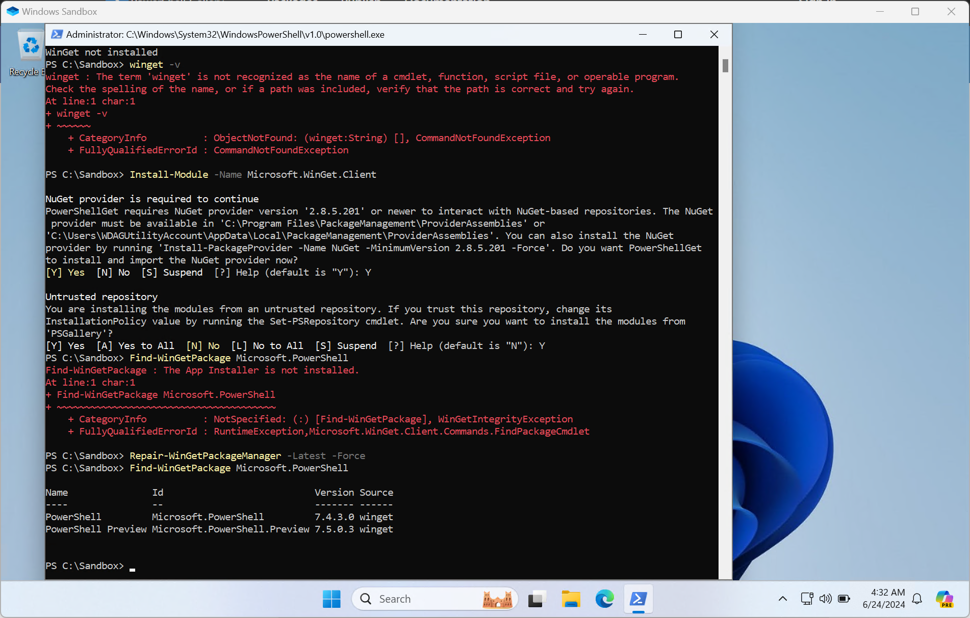
Bootstrapping Windows Sandbox

Slide 12
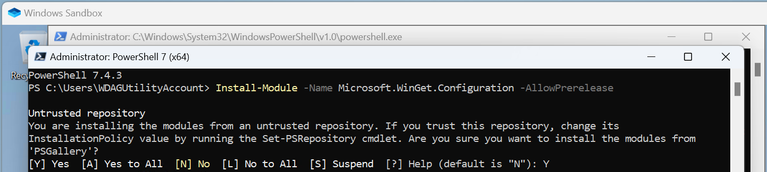
Continued

Slide 13
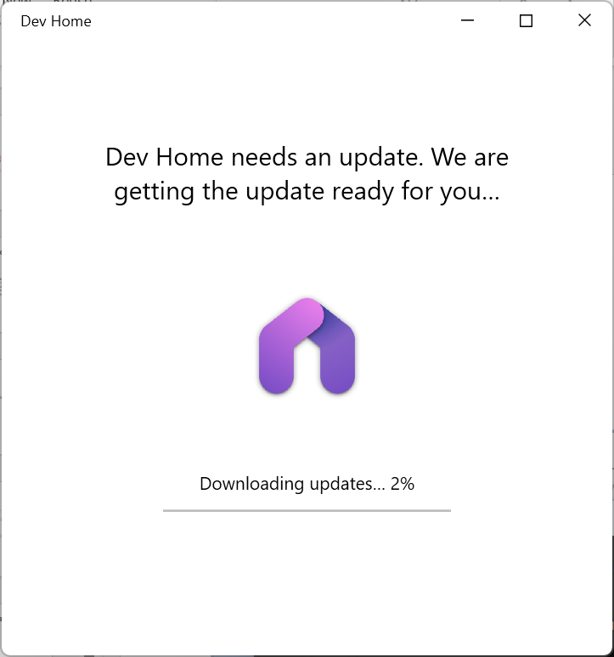
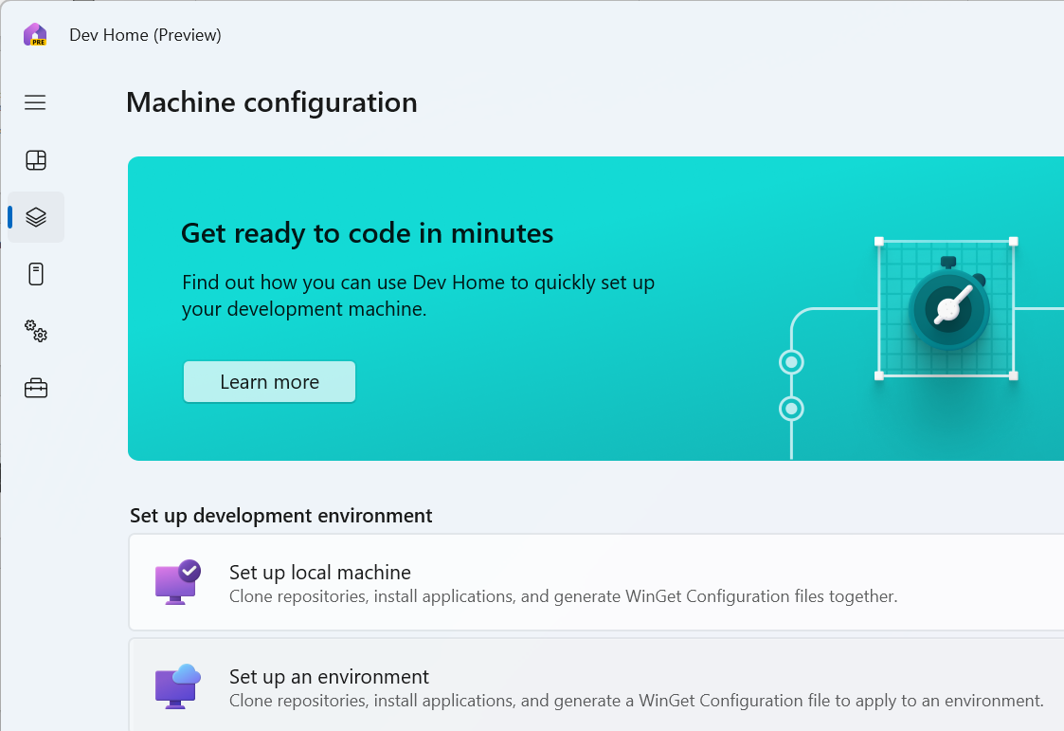
The easy button: Dev Home

Slide 14
Sharp Edges
Packaged applications calling DISM APIs
Mixed elevation requirements
System context (nt authority)
Discoverability

Slide 15
Links
Microsoft Learn: WinGet Configuration
https://learn.microsoft.com/windows/package-manager/configuration/
Sample Configurations in Dev Home project
https://aka.ms/dsc.yaml
Build apps from the cloud with Microsoft Dev Box, Visual Studio & more
Build apps from the cloud with Microsoft Dev Box, Visual Studio & more (DSC starts just after 21 minutes)
WinGet-DSC at GitHub
https://github.com/microsoft/winget-dsc

Slide 16
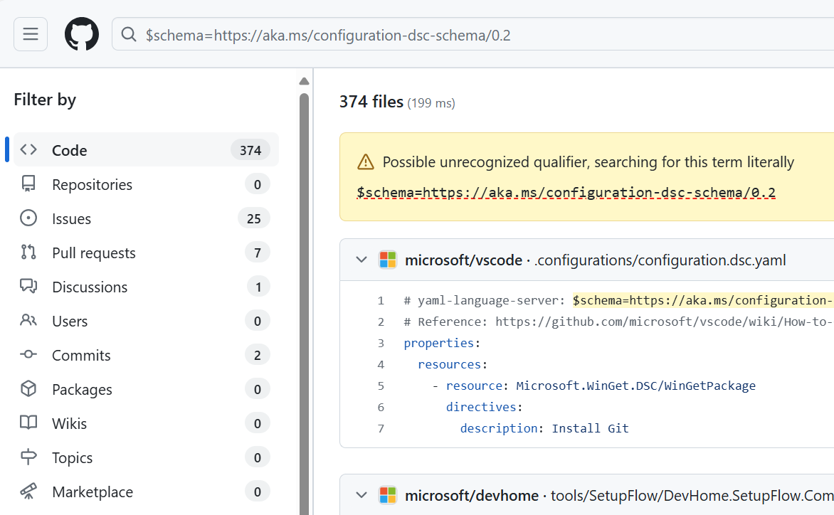
More Samples
Search for the JSON schema at GitHub
$schema=https://aka.ms/configuration-dsc-schema/0.2

Slide 17
Demos
We love Demos!

Slide 18
Q&A
15 minutes

